Slide 1

Patella Tendonopathy
11/09/19

Slide 2
What are tendons?
Tendons are dense connective tissue structures that are defined based on their anatomical position of connecting muscle to bone
Transmits muscle related force to the bone which results in movement around the joint
Two types of tendons
  “Positional”
  Energy Storage (1)
Notes:
Positional – Tib Ant type tendon
Energy storage – Achiiles/Patella

Slide 3
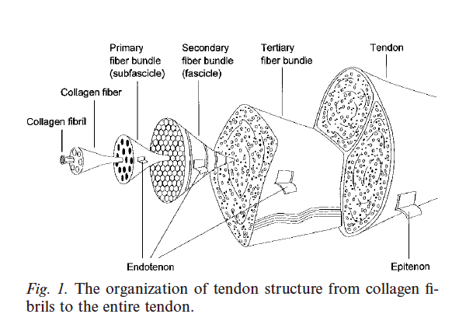
Tendon Structure
Paratenon
  Type 1, III and elastic fibrils
  Lined by synovial cells to allow for gliding of tendon sheaths
  Paratenon functions to allow for free movement of the tendon on the surrounding tissue
Epitenon
  Collagen strands 8-10nm in thickness
  Longitudinal, Transverse and oblique pattern
Endotendon
  Invests tendon fibers and binds them together
  Carries blood vessels, nerves, lymphatic
  Criss-crross pattern of fibers

Slide 4
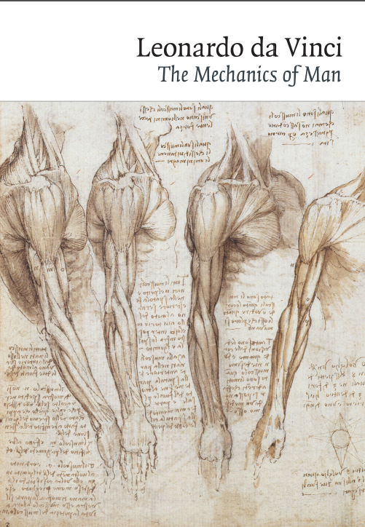
Tendon Structure
Paratenon
  Type 1, III and elastic fibrils
  Lined by synovial cells to allow for gliding of tendon sheaths
  Paratenon functions to allow for free movement of the tendon on the surrounding tissue
Epitenon
  Collagen strands 8-10nm in thickness
  Longitudinal, Transverse and oblique pattern
Endotendon
  Invests tendon fibers and binds them together
  Carries blood vessels, nerves, lymphatic
  Criss-crross pattern of fibers
Notes:
Leo da vinci – (1452-1519) – already discovered the spiral/longitudinal arrangement of muscle fibers

Slide 5
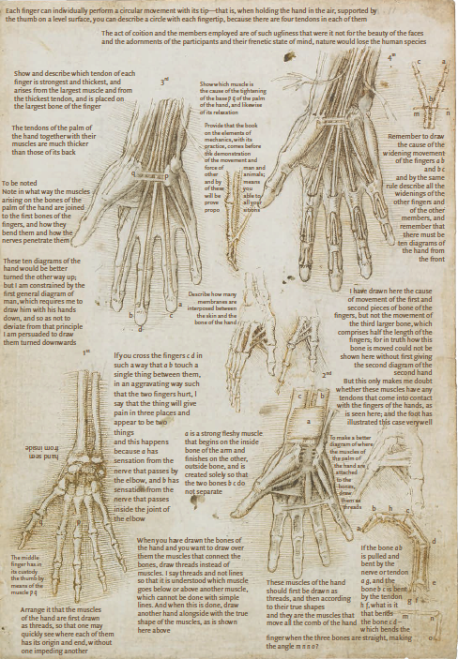
Tendon Structure
Paratenon
  Type 1, III and elastic fibrils
  Lined by synovial cells to allow for gliding of tendon sheaths
  Paratenon functions to allow for free movement of the tendon on the surrounding tissue
Epitenon
  Collagen strands 8-10nm in thickness
  Longitudinal, Transverse and oblique pattern
Endotendon
  Invests tendon fibers and binds them together
  Carries blood vessels, nerves, lymphatic
  Criss-crross pattern of fibers
Notes:
Leo da vinci – (1452-1519) – already discovered the spiral/longitudinal arrangement of muscle fibers.
The FDP was already noted to attach to the distal aspects of the 2-5th digits with FDS attaching through it.

Slide 6
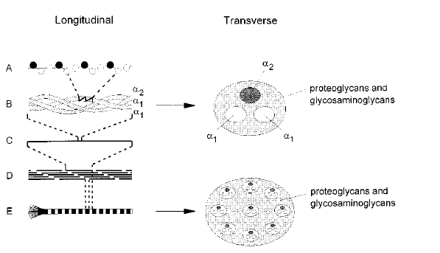
Internal Structure of tendons
Tendons consist of Collagen (Type 1 predominantly) 65-80%, Elastin 1-2% in a Proteoglycan matrix
A bunch of collagen fibrils form a collagen fiber
Subfasicle->Fasicle->Tertiary bundle/tendon
Collagen fiber and fibril size and quantity depend on the tendon
Elastic fibers are sparsely found in the human tendon
  ?Recovery of wavy form of the fiber
Ground substance consists of Glycosaminoglycans (GAGS), Proteoglycans (PG), glycoproteins and small molecules
  Allows for the resilience to compressive and shearing forces
Notes:
Formation of a type I collagen fibril: AóAmino acids join to form an a-chain. Glysine occupies every third position (black circles).
B and C Three a-chains coil to form the righthanded triple helix of a collagen molecule. The a-chains are surrounded by a thin layer of proteoglycans and glycosaminoglycans.
D - The collagen molecules link to form a tropocollagen molecule or microfibril. Within a microfibril (as well as fibril), the collagen molecules pack in a quarter staggered orientation (óeach collagen molecule overlaps its neighbor by a quarter of its length), producing the characteristic banding pattern of the final collagen fibril.
E-The striated collagen fibril. The microfibrils are surrounded by proteoglycans and glycosaminoglycans.

Slide 7
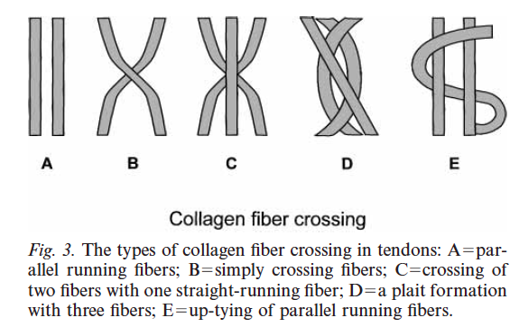
Internal Structure of tendons
Tendons consist of Collagen (Type 1 predominantly) 65-80%, Elastin 1-2% in a Proteoglycan matrix
A bunch of collagen fibrils form a collagen fiber
Subfasicle->Fasicle->Tertiary bundle/tendon
Collagen fiber and fibril size and quantity depend on the tendon
Elastic fibers are sparsely found in the human tendon
  ?Recovery of wavy form of the fiber
Ground substance consists of Glycosaminoglycans (GAGS), Proteoglycans (PG), glycoproteins and small molecules
  Allows for the resilience to compressive and shearing forces
Notes:
Formation of a type I collagen fibril: AóAmino acids join to form an a-chain. Glysine occupies every third position (black circles).
B and C Three a-chains coil to form the righthanded triple helix of a collagen molecule. The a-chains are surrounded by a thin layer of proteoglycans and glycosaminoglycans.
D - The collagen molecules link to form a tropocollagen molecule or microfibril. Within a microfibril (as well as fibril), the collagen molecules pack in a quarter staggered orientation (óeach collagen molecule overlaps its neighbor by a quarter of its length), producing the characteristic banding pattern of the final collagen fibril.
E-The striated collagen fibril. The microfibrils are surrounded by proteoglycans and glycosaminoglycans.

Slide 8
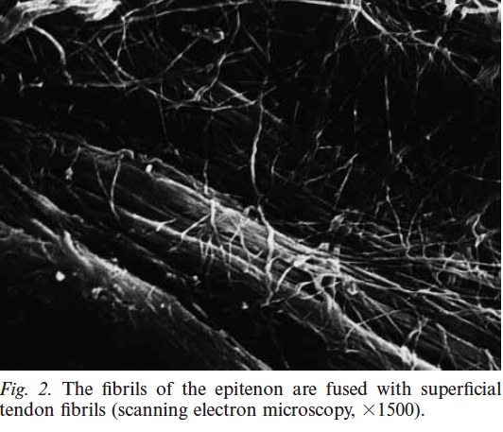
Internal Structure of tendons
Tendons consist of Collagen (Type 1 predominantly) 65-80%, Elastin 1-2% in a Proteoglycan matrix
A bunch of collagen fibrils form a collagen fiber
Subfasicle->Fasicle->Tertiary bundle/tendon
Collagen fiber and fibril size and quantity depend on the tendon
Elastic fibers are sparsely found in the human tendon
  ?Recovery of wavy form of the fiber
Ground substance consists of Glycosaminoglycans (GAGS), Proteoglycans (PG), glycoproteins and small molecules
  Allows for the resilience to compressive and shearing forces
Notes:
Formation of a type I collagen fibril: AóAmino acids join to form an a-chain. Glysine occupies every third position (black circles).
B and C Three a-chains coil to form the righthanded triple helix of a collagen molecule. The a-chains are surrounded by a thin layer of proteoglycans and glycosaminoglycans.
D - The collagen molecules link to form a tropocollagen molecule or microfibril. Within a microfibril (as well as fibril), the collagen molecules pack in a quarter staggered orientation (óeach collagen molecule overlaps its neighbor by a quarter of its length), producing the characteristic banding pattern of the final collagen fibril.
E-The striated collagen fibril. The microfibrils are surrounded by proteoglycans and glycosaminoglycans.
Low metabolic activity means that the cells involved in accomodating strain are anaerobically driven – great as tendons need to maintain tension for long periods of time without suffering from iscahemia. Drawback to this is during the healing process

Slide 9
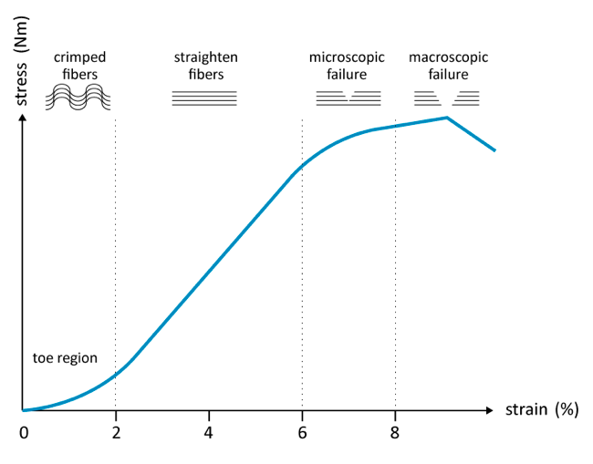
Internal Structure of tendons
Tendons consist of Collagen (Type 1 predominantly) 65-80%, Elastin 1-2% in a Proteoglycan matrix
A bunch of collagen fibrils form a collagen fiber
Subfasicle->Fasicle->Tertiary bundle/tendon
Collagen fiber and fibril size and quantity depend on the tendon
Elastic fibers are sparsely found in the human tendon
  ?Recovery of wavy form of the fiber
Ground substance consists of Glycosaminoglycans (GAGS), Proteoglycans (PG), glycoproteins and small molecules
  Allows for the resilience to compressive and shearing forces
Barfod, Kristoffer. (2014). Achilles tendon rupture; Assessment of nonoperative treatment. Danish medical journal. 61. B4837.
Notes:
Formation of a type I collagen fibril: AóAmino acids join to form an a-chain. Glysine occupies every third position (black circles).
B and C Three a-chains coil to form the righthanded triple helix of a collagen molecule. The a-chains are surrounded by a thin layer of proteoglycans and glycosaminoglycans.
D - The collagen molecules link to form a tropocollagen molecule or microfibril. Within a microfibril (as well as fibril), the collagen molecules pack in a quarter staggered orientation (óeach collagen molecule overlaps its neighbor by a quarter of its length), producing the characteristic banding pattern of the final collagen fibril.
E-The striated collagen fibril. The microfibrils are surrounded by proteoglycans and glycosaminoglycans.
Low metabolic activity means that the cells involved in accomodating strain are anaerobically driven – great as tendons need to maintain tension for long periods of time without suffering from iscahemia. Drawback to this is during the healing process

Slide 10
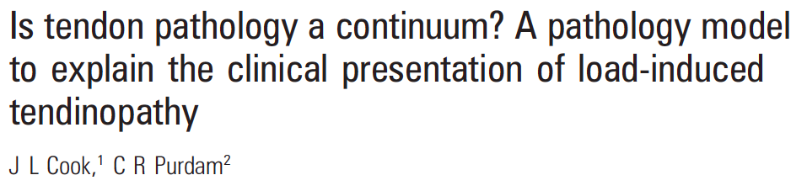
Continuum of Tendon Pathology

Slide 11
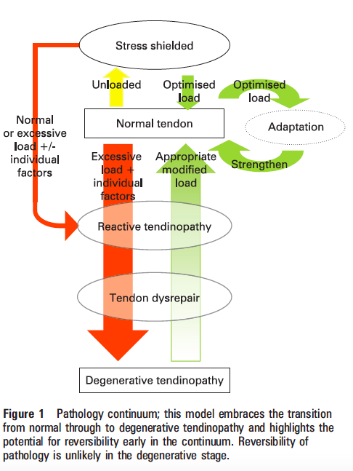
Continuum of Tendon Pathology

Slide 12
New model of tendon Pathology
Reactive Tendonopathy
  Non-inflammatory adaption to compressive and tensile overload
  Can also be seen after a direct fall or trauma to the area
  Increased proteins with influx of water bound to PG – manifests as thickening of the tendon
  Collagen integrity is intact
  Study done by Fisker et al. 2017 on 34 healthy subjects
    Tendon changes in Achilles and Patella tendon within 90 seconds of a Crossfit workout

Slide 13
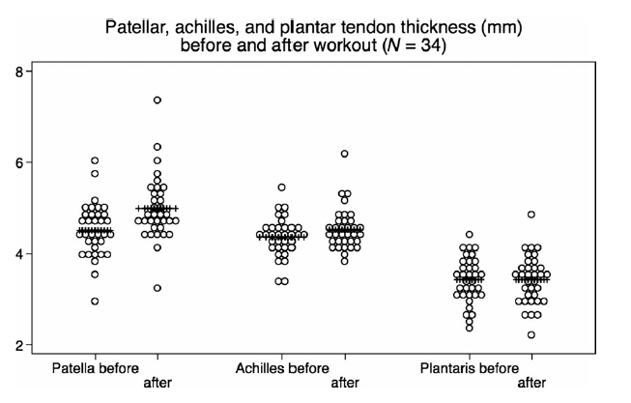
New model of tendon Pathology
Reactive Tendonopathy
  Non-inflammatory adaption to compressive and tensile overload
  Can also be seen after a direct fall or trauma to the area
  Increased proteins with influx of water bound to PG – manifests as thickening of the tendon
  Collagen integrity is intact
  Study done by Fisker et al. 2017
    Tendon changes in Achilles and Patella tendon within 90 seconds of a Crossfit workout

Slide 14
New model of tendon Pathology
Tendon Dysrepair
  Increased ground substance with increased number of cells
  Increased vascularity and neuronal ingrowth
  Difficult to distinguish clinically but often the chronicity in a young patient will lead one to this stage.
  Some reversibility is possible with load management and excercise
Notes:
U

Slide 15
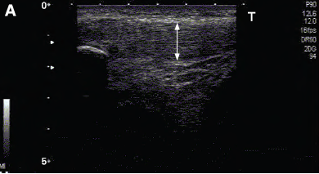
New model of tendon Pathology
Tendon Dysrepair
  Increased ground substance with increased number of cells
  Increased vascularity and neuronal ingrowth
  Difficult to distinguish clinically but often the chronicity in a young patient will lead one to this stage.
  Some reversibility is possible with load management and excercise
Cook JL, Purdam CR Is tendon pathology a continuum? A pathology model to explain the clinical presentation of load-induced tendinopathy British Journal of Sports Medicine 2009;43:409-416.
Notes:
U

Slide 16
New model of tendon Pathology
Degenerative tendon
  Marked cell death and apoptosis with islands of accelularity
  Disordered matrix, collagen and increased vascularity
  These are typical the older patients with focal thickening of tendons
  Can also be seen in high-level/elite athletes with chronic overuse
High risk of rupture – 97% of ruptured tendons showed features of degeneration. (4)

Slide 17
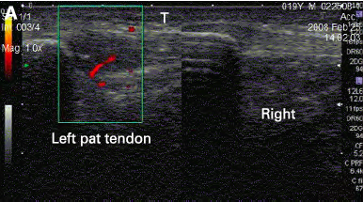
New model of tendon Pathology
Degenerative tendon
  Marked cell death and apoptosis with islands of accelularity
  Disordered matrix, collagen and increased vascularity
  These are typical the older patients with focal thickening of tendons
  Can also be seen in high-level/elite athletes with chronic overuse
High risk of rupture – 97% of ruptured tendons showed features of degenration. (4)
Cook JL, Purdam CR Is tendon pathology a continuum? A pathology model to explain the clinical presentation of load-induced tendinopathy British Journal of Sports Medicine 2009;43:409-416.

Slide 18
How do we then guide treatment?
Reactive Tendonopathy
Young athlete
Acute Overload
Fusiform swelling
Degenerative
Older athlete
Nodular swelling

Slide 19
Patella Tendonopathy
Load related pain at the inferior pole of the patella
  Increased activity of the knee extensors with activities that store and release energy in the tendon e.g. tennis, football, hockey, athletic jump events
  Repetition and inadequate rest are the risk factors for development
  Pain rarely occurs in the resting state (8)
  Dose dependent pain with loading of the tendon is the hallmark of patella tendonopathy
Notes:
Pain should increase when progressing from shallow to deeper squat due to increased loading

Slide 20
Clinical Assessment
Location of pain
Nature of pain
Biomechanical assessment
Notes:
Location of pain – inferior pole of patella
Tendinopathic pain is induced by load and has two key features: (1) dose-dependent pain in relation to singular or cumulative load, and (2) pain that is well localised to the tendon or enthesis. Increasing load on the tendon will usually increase pain. During assessment, the tendon should be provocatively loaded to functional levels to fully evaluate the level of pain. In some cases pain is present on sitting/driving etc, but this can often be a sign of another disease process.
Pain irritability is an important factor when assessing tendon pain – tendon pain that settles within 24 hours of rehab is acceptable, irritable tendons have pain after 24 hours.
VISA P can be used to score – scale of 100, with higher scores repreting higher function and less pain.
Biomechanic assesment includes hopping and jumping if that is what is needed. Glutes, hamstrings, quadriceps, foot posture, ankle dorsiflexion have all been linked to patella tendonopathy – Study done by Henk Van Der Worp – Systematic review of literature looking at Jumping vs landing – showed that greater ROM in the landing phase was associated with decreased reinjury

Slide 21
Differential Diagnosis
Quadriceps tendonopathy
Distal insertional tendonopathy
Patelofemoral pain
Hoffas fat pad impingement
Plica lesions
Notes:
Quadriceps tendinopathy is characterized by pain localized to the quadriceps tendon32 and, in the authors’ experience, is often associated with movements requiring deep knee flexion, such as those performed by volleyballers and weight lifters.72
Distal patellar tendon pain, often seen in distance runners, is localized near the tibial tuberosity.32,78 The infrapatellar bursa is an intimate part of the distal patellar tendon
Patellofemoral-related pain is generally located diffusely around the patella on pain mapping,68 compared with the typically localized inferior pole of the patella in patellar tendinopathy. Patients with PFP also present with pain on low loading activities – walking, running or cycling
Plica lesions often of the superior plica

Slide 22
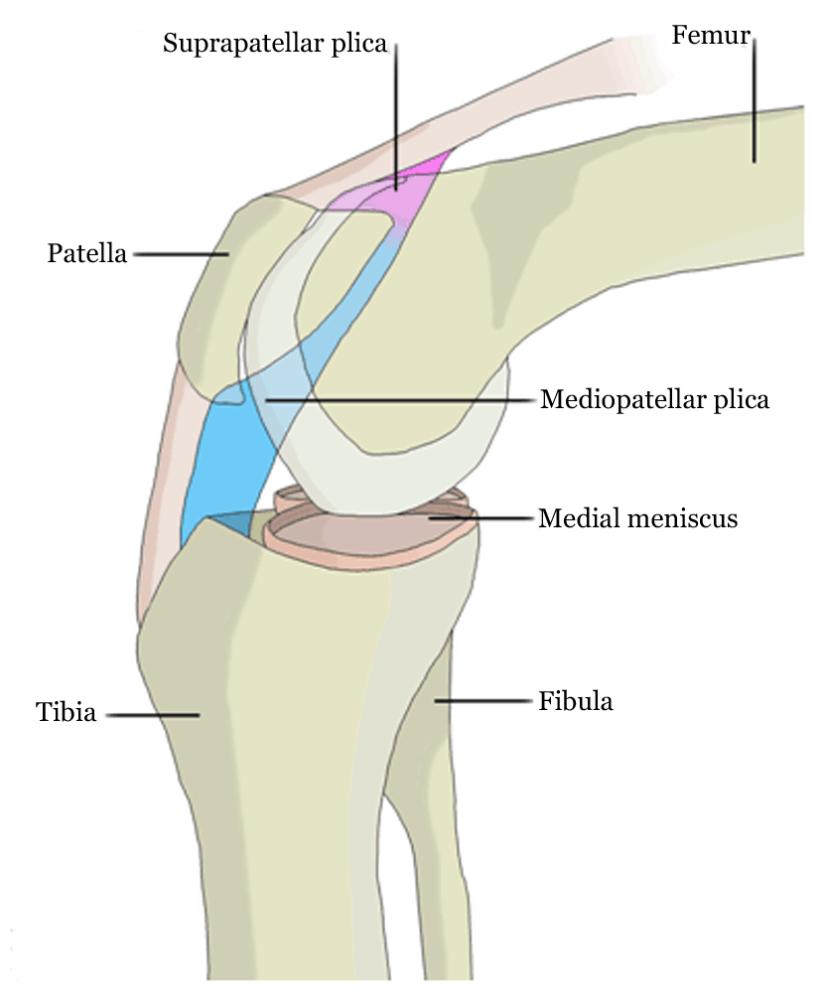
Differential Diagnosis
Quadriceps tendonopathy
Distal insertional tendonopathy
Patelofemoral pain
Hoffas fat pad impingement
Plica lesions
Hoehmann CL. Plica syndrome and its embryological origins. Edorium J Orthop 2017;3:1–12.
Notes:
Quadriceps tendinopathy is characterized by pain localized to the quadriceps tendon32 and, in the authors’ experience, is often associated with movements requiring deep knee flexion, such as those performed by volleyballers and weight lifters.72
Distal patellar tendon pain, often seen in distance runners, is localized near the tibial tuberosity.32,78 The infrapatellar bursa is an intimate part of the distal patellar tendon
Patellofemoral-related pain is generally located diffusely around the patella on pain mapping,68 compared with the typically localized inferior pole of the patella in patellar tendinopathy. Patients with PFP also present with pain on low loading activities – walking, running or cycling
Plica lesions often of the superior plica present like a quadricep tendonopathy – medial plicas often involved but wont present with anterior knee pain. Painful o walking and often on shallow flexion – managed with NSAIDs and STTM of quadricep

Slide 23
Differential Diagnosis
Quadriceps tendonopathy
Distal insertional tendonopathy
Patelofemoral pain
Hoffas fat pad impingement
Plica lesions
Osteochondral lesions
Osgood Schlatter
Sinding-Larsen Johanson
Notes:
Quadriceps tendinopathy is characterized by pain localized to the quadriceps tendon32 and, in the authors’ experience, is often associated with movements requiring deep knee flexion, such as those performed by volleyballers and weight lifters.72
Distal patellar tendon pain, often seen in distance runners, is localized near the tibial tuberosity.32,78 The infrapatellar bursa is an intimate part of the distal patellar tendon
Patellofemoral-related pain is generally located diffusely around the patella on pain mapping,68 compared with the typically localized inferior pole of the patella in patellar tendinopathy. Patients with PFP also present with pain on low loading activities – walking, running or cycling
Osteochondral lesions of the inferior pole of the patella can present like a patella tendonopathy, usually have an effusion

Slide 24
Management
Reactive Tendonopathy
  Load modification
  Ibuprofen/Celecoxib preffered
Late Tendon dysrepair/Tendon degeneration
  Frictions
  ECSW
  U/S
Notes:
Studiesshow that tendon response in type 1 collagen precursors peaks around 3 days after a single bout of intense exercise, suggesting that time interval for adaptive response is an important factor.Tendon load without energy storage and release, such as cycling or strength-based weight training, can be maintained, as this isless likely to induce further tendon response.
Treatments that stimulate cell activity, increase protein production (collagen or ground substance) and restructure the matrix are appropriate for this stage of tendinopathy.

Slide 25
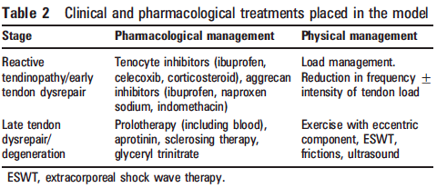
Management
Reactive Tendonopathy
  Load modification
  Ibuprofen/Celecoxib preffered
Late Tendon dysrepair/Tendon degeneration
  Frictions
  ECSWT
  U/S
Notes:
Treatments that stimulate cell activity, increase protein production (collagen or ground substance) and restructure the matrix are appropriate for this stage of tendinopathy
Studies show that tendon response in type 1 collagen precursors peaks around 3 days after a single bout of intense exercise, suggesting that time interval for adaptive response is an important factor.Tendon load without energy storage and release, such as cycling or strength-based weight training, can be maintained, as this isless likely to induce further tendon response.
Prolotherapy using glucose and blood injections stimulates a tissue response. Blood injection stimulates cell proliferation and production of vascular endothelial growth factor,60 and it has been demonstrated to induce matrix changes

Slide 26
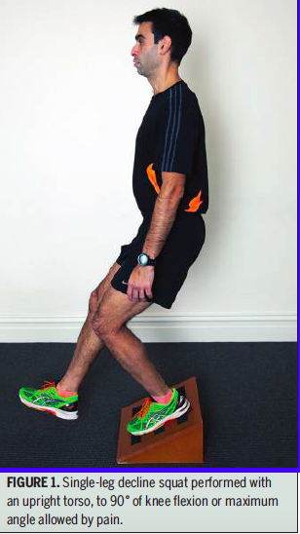
Management
Exercise therapy
  Most researched management protocol
Eccentric protocol
  3 sets of 15 reps twice daily
  12 weeks
The question is now, how effective is eccentrics alone?
  We’re not addressing the kinetic chain
  How good is the evidence actually for eccentrics

Slide 27
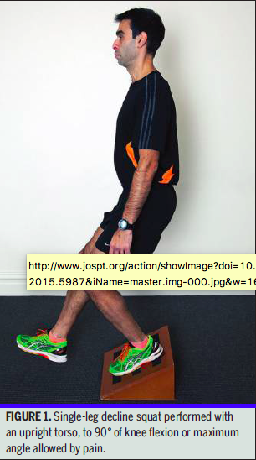
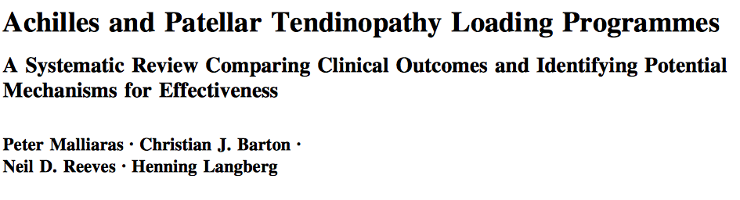
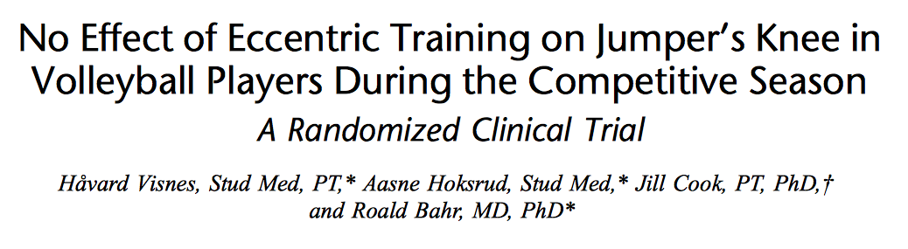
Management
Eccentric protocol
  3 sets of 15 reps twice daily
11 years on – the question is now, how effective is eccentrics alone?
Problem is that we’re not quite addressing any of the kinetic chain issues
Notes:
The final yield included 32 studies; ten compared loading programmes and 28 investigated at least one potential mechanism (six studies compared loading programmes and investigated potential mechanisms). This review has identified limited (Achilles) and conflicting (patellar) evidence that clinical outcomes are superior with eccentric loading compared with other loading programmes, questioning the currently entrenched clinical approach to these injuries. HSR loading essentially superior – 2014
Study done in Norway – 29 players followed for 12 weeks.Control group did no eccetnrics, 12 remainder did eccentic. No change in VISA-P

Slide 28
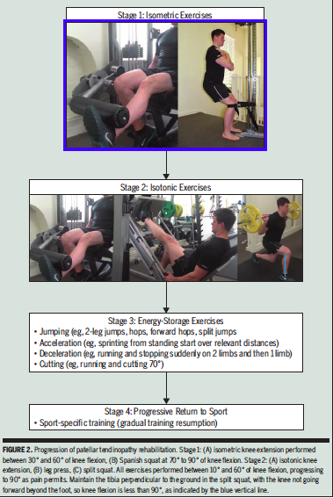
Notes:
Focus is to develop load tolerance of the tendon and msk unit and kinetic chain.
Pain strength and function is the key.

Slide 29
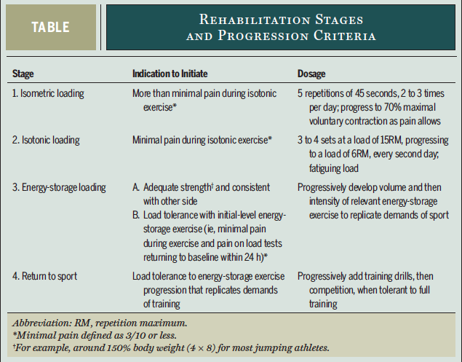
Exercise protocol
Load tolerance test
  Single leg decline squat (daily)
Isometric
  Can last for a few weeks (daily)
Isotonic
  Initiate when pain on performing is >3/10
  Important for muscle bulk and strength
Energy storage loading (72 hours)
  Phase initiation
  Rate of loading
  Athlete dependant but volume>intensity
Return to sport
  Stage 3 should match training drills and then integrate
  RTS when load tolerance is managed with minimal pain
Maintenance
Notes:
Limit knee flexion to 10 to 60 degree – progressing to 90 degrees
Stage2 is important to aid in strengthening of opposite side – therfore single leg lunge, leg press macine, leg extension
Progress from 15RM to 6RM every second day
Still NB to monitor the pain from loading to ensure theres no over load of the tendon.
Rate of laoding of the tendon is VNB – leg press – 5.2 body weight and 2 body weight per second. Landing from jump is 5.17 body weight 38.6 BW/second.
Stop/Land/Jump – 6.6 body weight and 93 body weight per second.
Loading depends on the type of athlete – jumping, running etc. and needs to be tailored accordingly.
Load tolerane test can be done the day after and should always remain <3/10 pain to continue – if not – back to isometrics for a few days and then isotonics and then Energy storage. This is the most aggressive stage.
RTS – no more than 3 high intensity training or competition per week – for a year in the recovering tendon.

Slide 30
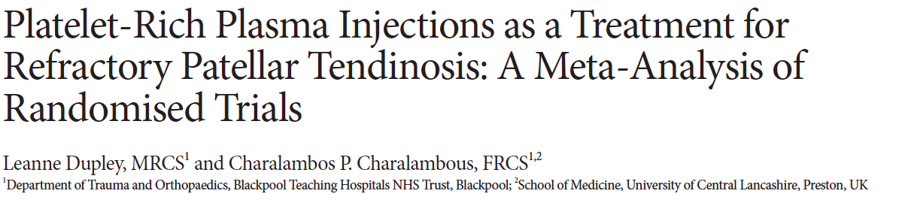
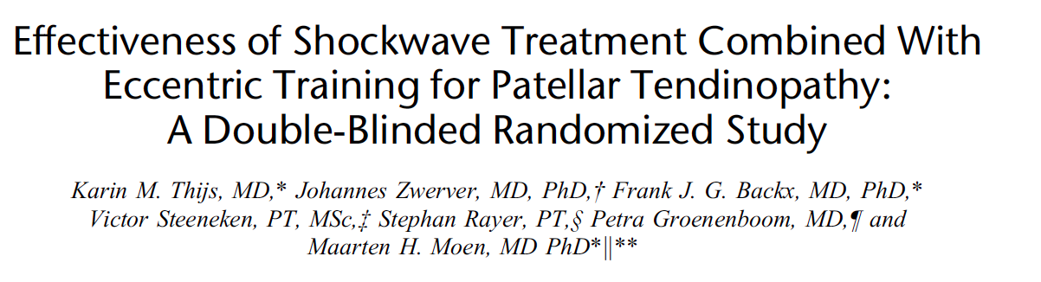
PRP and Shockwave
Notes:
PRP – meta-analysis looked at PRP in its use for refractory PT – one study with 21 patients, another with 46. Saw an improvement on VISA-P after 12 months as compared to ECSW
Extracorporeal shockwave therapy and sham shockwave were applied in 3 sessions at 1-week intervals with a piezoelectric device. All participants were instructed to perform eccentric exercises (3 sets of 15 repetitions twice a day) for 3 months on a decline board at home.
No significant differences for the primary and secondary outcome measures were found between the groups. In the ESWT/ eccentric group, the VISA-P increased from 54.5 6 15.4 to 70.9 6 17.8, whereas the VISA-P in the sham-shockwave/ eccentric group increased from 58.9 6 14.6 to 78.2 6 15. (between-group change in VISA-P at 24 weeks 24.8; 95% confidence interval, 212.7 to 3.0, P = 0.150).
Basically – jury is out i think. There is SOME evidence for it working, but still fairly poor evidence.

Slide 31
References
Rio E, Moseley L, Purdam C, et al. The pain of tendinopathy: physiological or pathophysiological? Sports Med. 2014;44:9-23. http://dx.doi. org/10.1007/s40279-013-0096-z
Van der Worp H, de Poel HJ, Diercks RL, van den Akker-Scheek I, Zwerver J. Jumper’s knee or lander’s knee? A systematic review of the relation between jump biomechanics and patellar tendinopathy. Int J Sports Med. 2014;35:714- 722. http://dx.doi.org/10.1055/s-0033-1358674
Kannus P, Structure of the tendon connective tissue. Scan J Med Sci Sports 2000:10: 312-320
Kannus P, Jozsa L. Histopathological changes preceding spontaneous rupture of a tendon. A controlled study of 891 patients. J Bone Joint Surg Am 1991;73:1507–25.)
Cook JL, Purdam CR Is tendon pathology a continuum? A pathology model to explain the clinical presentation of load-induced tendinopathy British Journal of Sports Medicine 2009;43:409-416.
Barfod, Kristoffer. (2014). Achilles tendon rupture; Assessment of nonoperative treatment. Danish medical journal. 61. B4837.
Malliaras, Peter & Cook, Jill & Purdam, Craig & Rio, Ebonie. (2015). Patellar Tendinopathy: Clinical Diagnosis, Load Management, and Advice for Challenging Case Presentations. The Journal of orthopaedic and sports physical therapy. 45. 1-33. 10.2519/jospt.2015.5987.
﻿Rio E, Moseley L, Purdam C, et al. The pain of tendinopathy: physiological or pathophysiologi- cal? Sports Med. 2014;44:9-23. http://dx.doi. org/10.1007/s40279-013-0096-z

